Slide 1
AmazingMartEU2 - Map, Scatter plot, Dashboard
File created on: 8/11/2020 12:51:58 AM

Slide 2
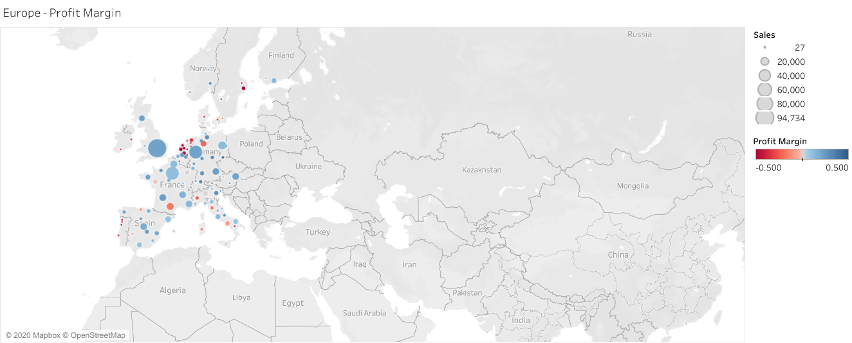

Slide 3
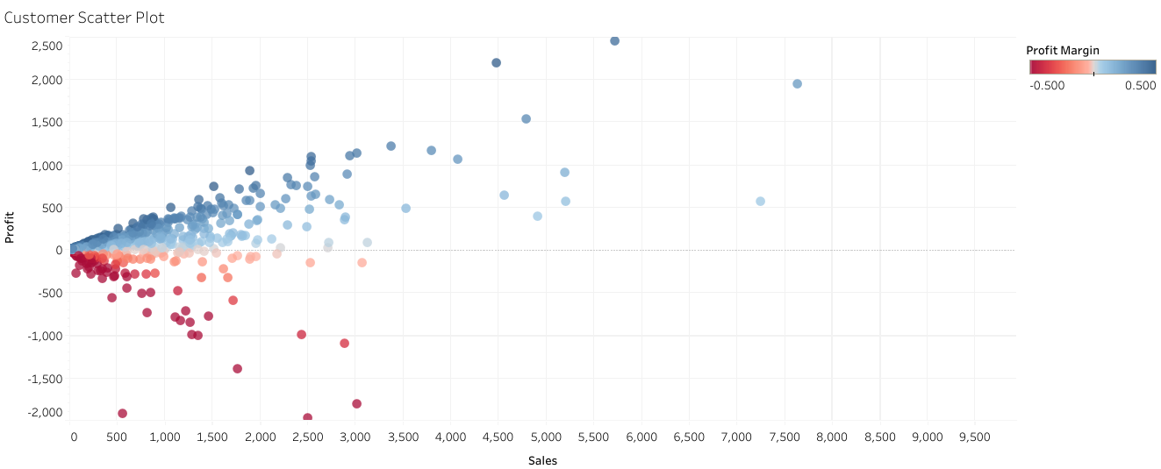

Slide 4
